Slide 1
Tanmay gaikwad
PROJECT TOPIC : Library management

Slide 2
introduction
Libraries are essential institutions for accessing, borrowing, and managing knowledge resources . Managing a modern library involves tracking books, borrowers, due dates, and returns efficiently. This project presents a Library Management System implemented using SQL to organize and retrieve data effectively. The system is designed to handle book inventory, user information, issue/return transactions, and more.

Slide 3
abstract
The Library Management System database is designed using SQL to provide a structured solution for storing and managing library data. It includes multiple interrelated tables such as books, members, transactions (issues/returns), and staff. The project showcases key SQL features including table creation, data insertion, joins, aggregations, and queries to retrieve real-time information like book availability or overdue items. This system aims to improve efficiency, accuracy, and accessibility within library operations.

Slide 4
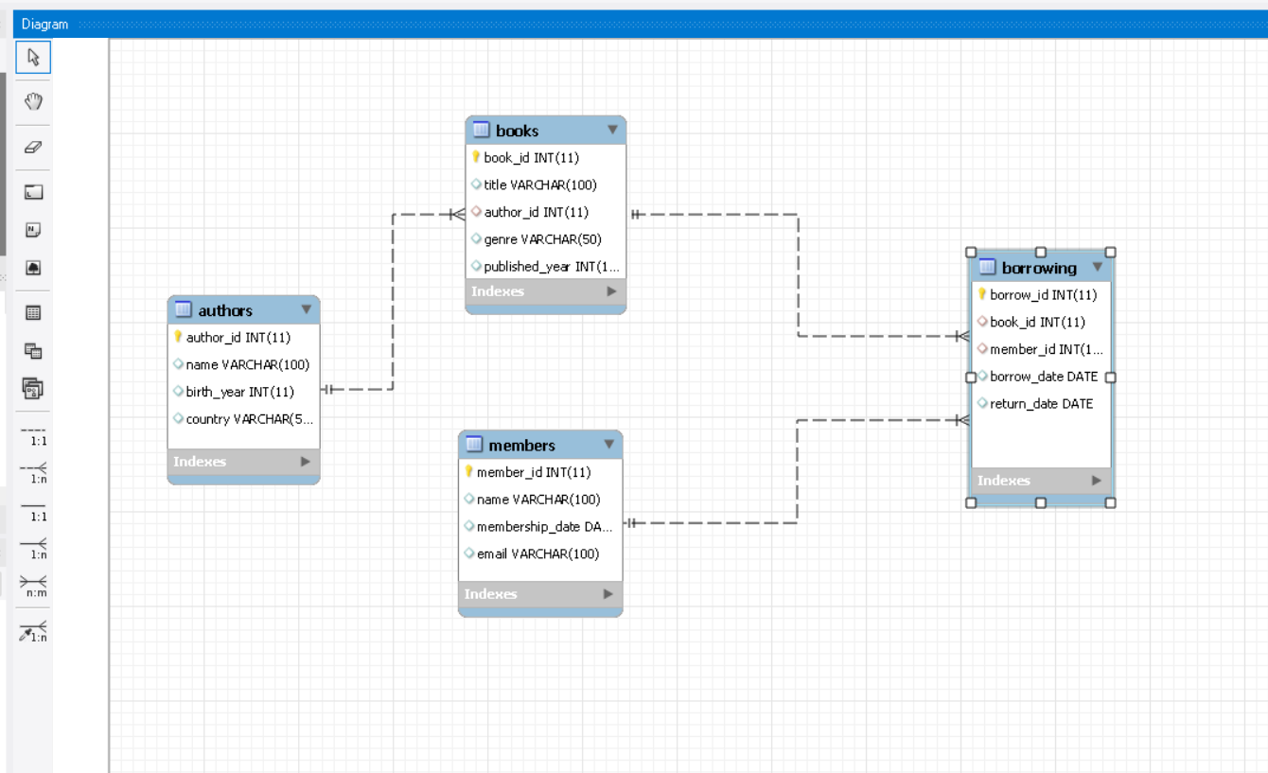
ER DIAGRAM
ER Diagram is used to visually represent the structure and relationships within a database or information system.

Slide 5
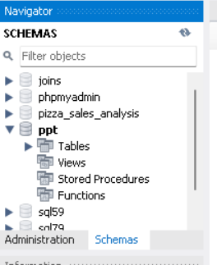
SCHEMA
A Schema in SQL is a collection of database objects associated with a database. The username of a database is called a Schema owner (owner of logically grouped structures of data). Schema always belong to a single database whereas a database can have single or multiple schemas

Slide 6
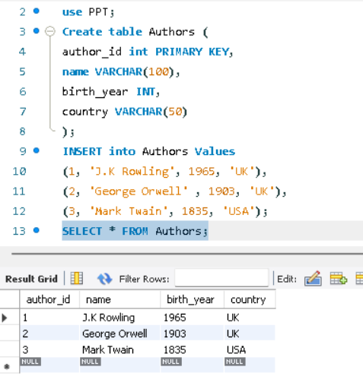
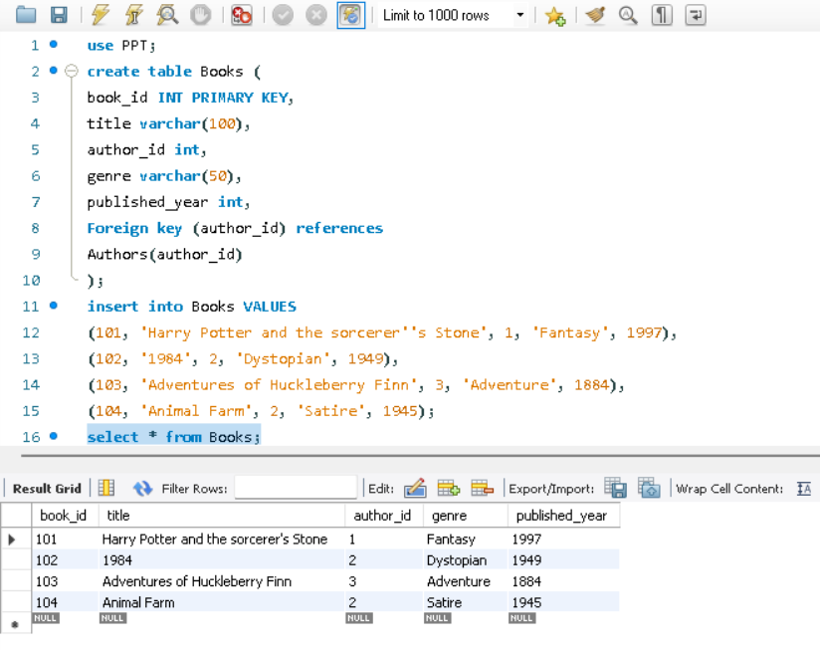
Table structure
TABLE NO 2
Books
TABLE NO 1
Authors

Slide 7
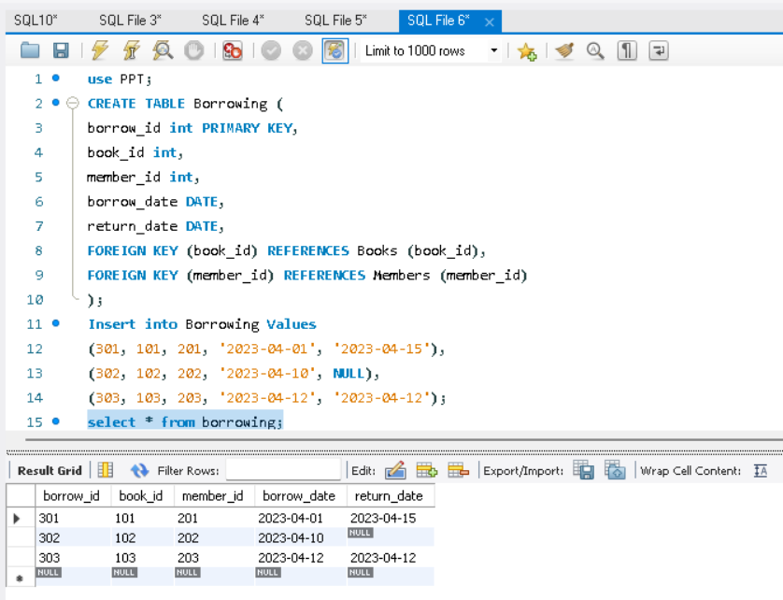
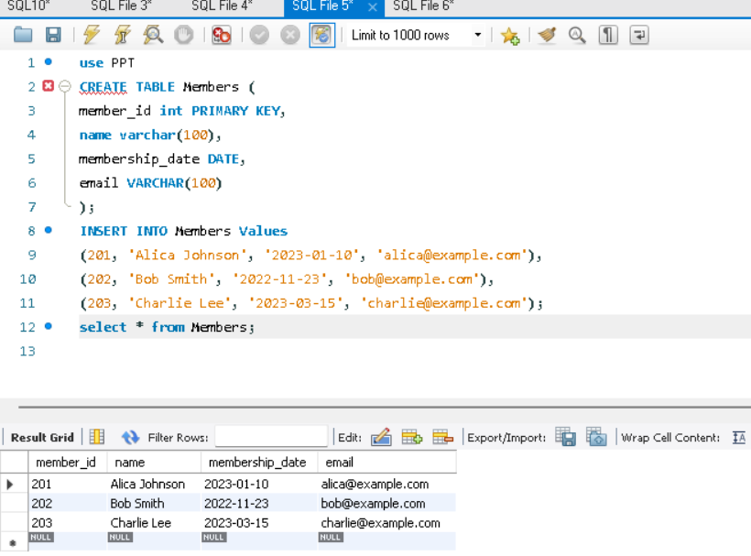
TABLE STRUCTURE
TABLE NO 4
Borrowing
TABLE NO 3
Members

Slide 8
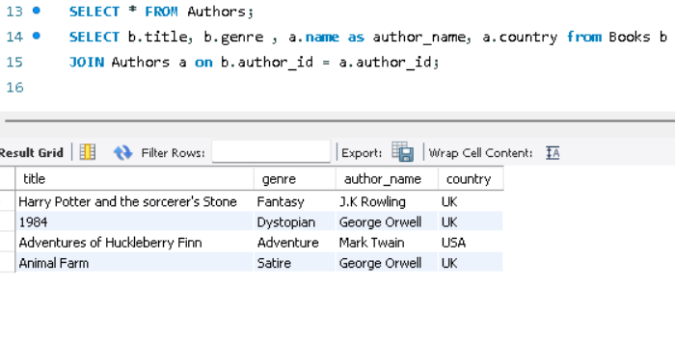
join
Use join from Books and expected output as title, genre, name as author_name.
The purpose of JOINs in SQL is to access data from multiple tables based on logical relationships between them. JOINS are used to fetch data from database tables and represent the result dataset as a separate table.

Slide 9
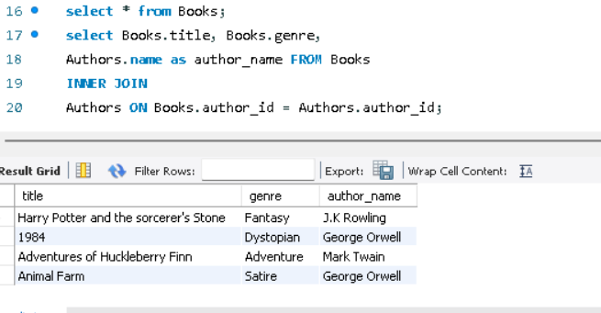
Inner join
Use inner join from books and expected output title , genre , and author name.
An Inner Join in SQL is a method used to combine rows from two or more tables based on a related column between them. It retrieves only the rows that have matching values in both tables involved in the join.

Slide 10
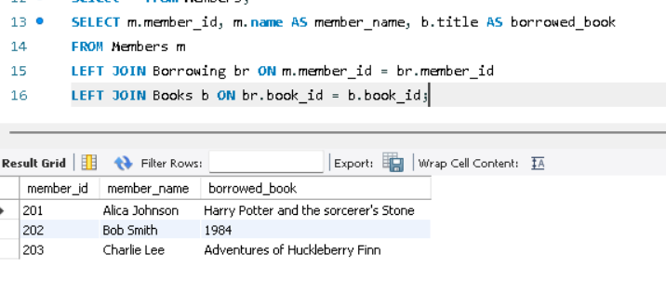
Left join
Use left join on borrowing and books from members table give output m. member id, m.name as member name, title as borrowed book

Slide 11
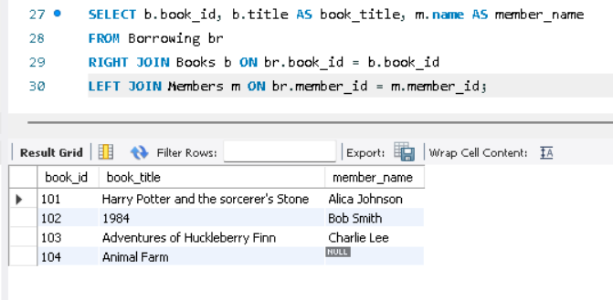
Right join and left join
Use right join on books and left join in members from borrowing table . Give output book id , title as book title,
Name as member name from borrowing table

Slide 12
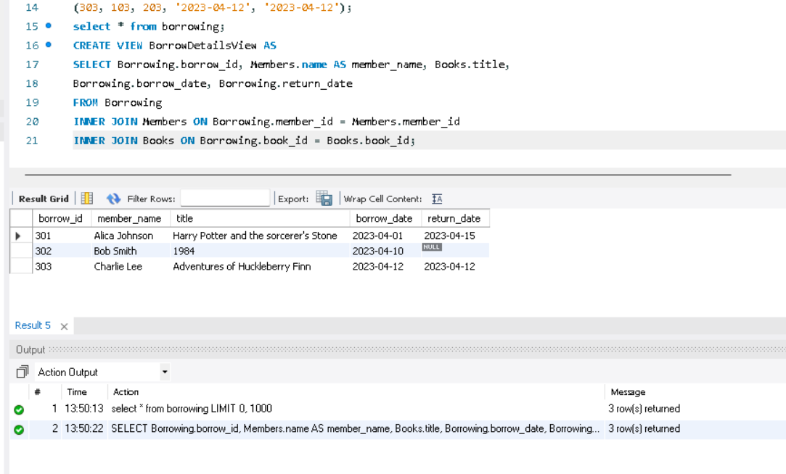
View
Use view BorrowDetailsView from Borrowing and expected output borrow_id, member_id, title, borrow_date and return_date.
Views can be used as security mechanisms by letting users access data through the view, without granting users permissions to directly access the underlying tables of the query. Views can be used to provide a backward compatible interface to emulate a table that used to exist but whose schema has changed.

Slide 13
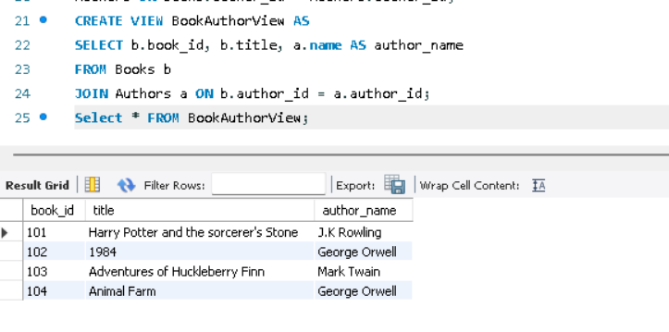
view
Create a view to show all books along with their author’s name. Output as book id , title author name from books

Slide 14
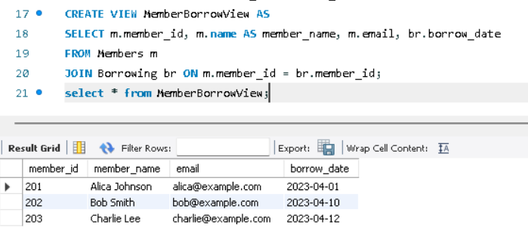
view
Create view to show members along with email and the date they borrowed a book.

Slide 15
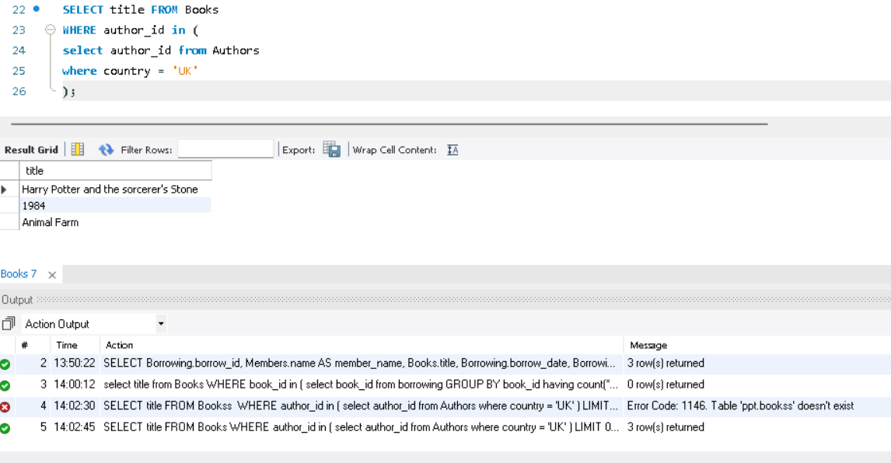
Sub query
Find books written by authors from the UK

Slide 16
COUNCLUSION
The SQL-based Library Management System successfully demonstrates how relational databases can streamline library operations. It ensures accurate tracking of books, borrowing records, and member activities. SQL queries allow for efficient report generation and decision-making based on real-time data . This foundational system can be extended with a graphical interface, user authentication, and integration with external cataloging services in the future.

